Slide 1
CIS Foundations of Machine Learning
Chapter 13
Fundamentals of Deep Learning

Slide 2
Outline
Introduction
What is Deep Learning?
What is neural network?
What characteristics that make it better?
Why now and Why deep?
Fundamental Building Blocks and Operations
Perceptron
Activation Functions
Working with Keras and Tensor Flow

Slide 3
Outline
Introduction
What is Deep Learning?
What is neural network?
What characteristics that make it better?
Why now and Why deep?
Fundamental Building Blocks and Operations
Perceptron
Activation Functions
Working with Keras and Tensor Flow

Slide 4
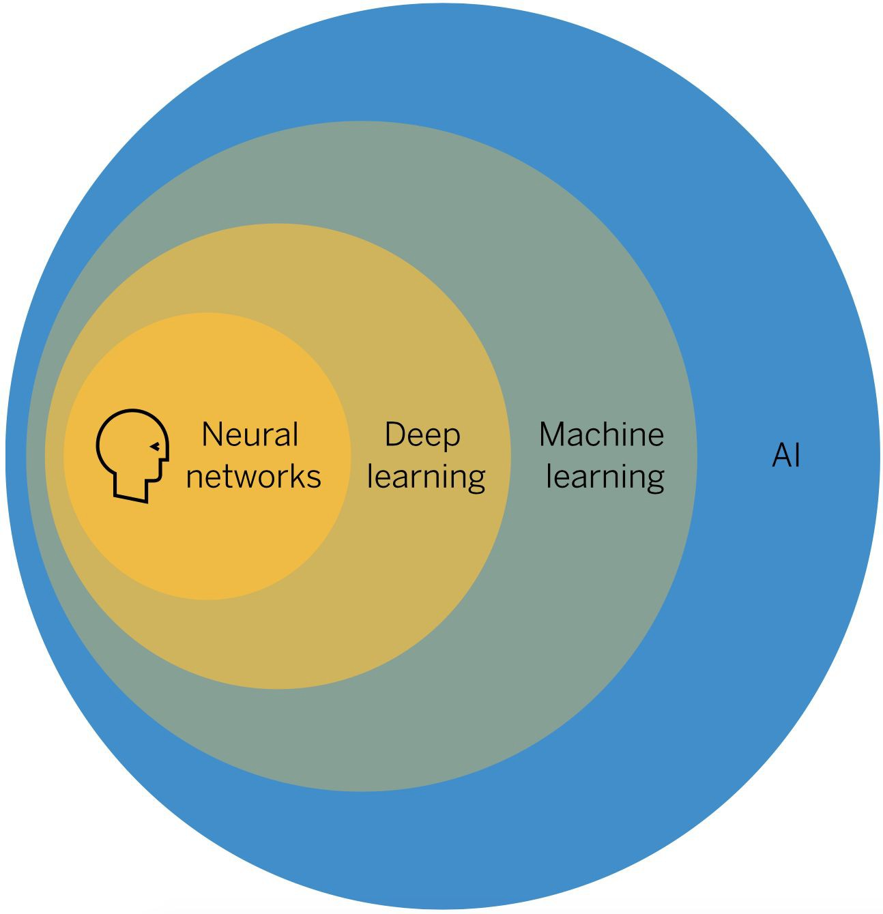
What is Deep Learning
❏ A type of machine learning based on artificial neural networks in which multiple layers of processing are used to extract progressively higher level features from data.

Slide 5
What is Deep Learning
Artificial
Intelligence
Machine
Learning
Data Analytics
Machine Learning
(classical or shallow)
Deep
Learning
Statistics
Data Science

Slide 6
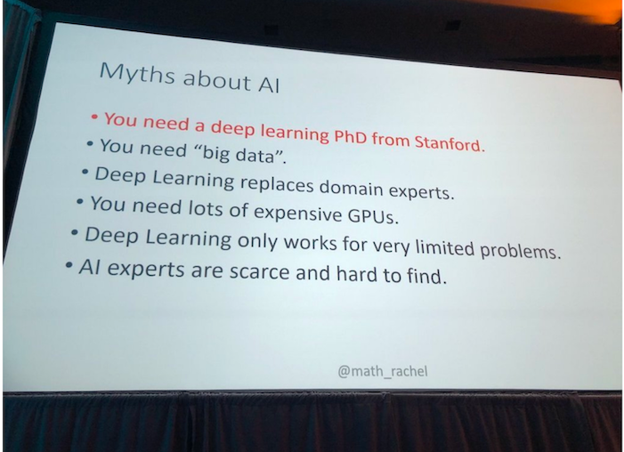
What is Deep Learning

Slide 7
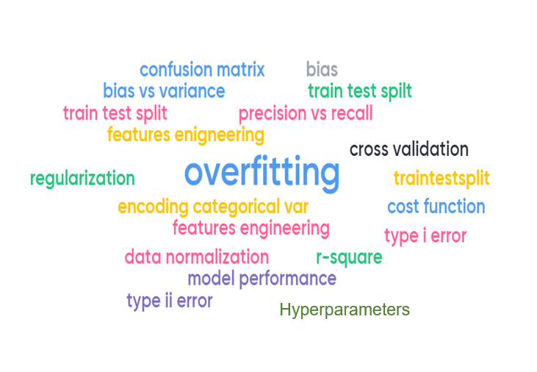
Common Terminology in Machine Learning

Slide 8
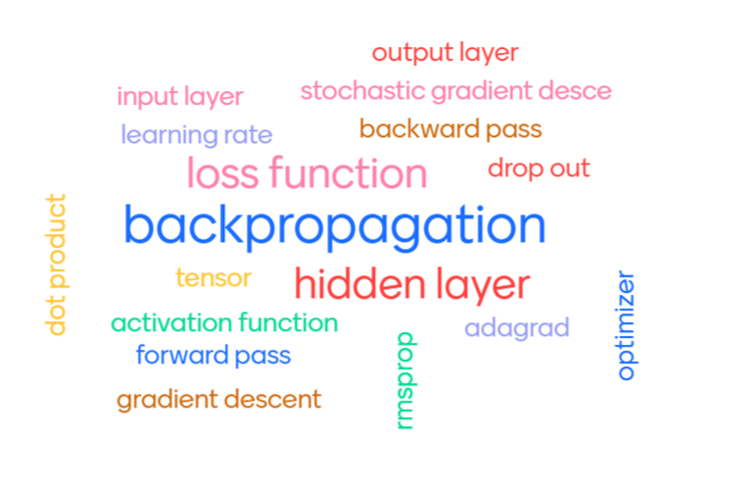
Common Terminology in Deep Learning

Slide 9
What is Deep Learning
Deep Learning is based on neural network
What is neural network?

Slide 10
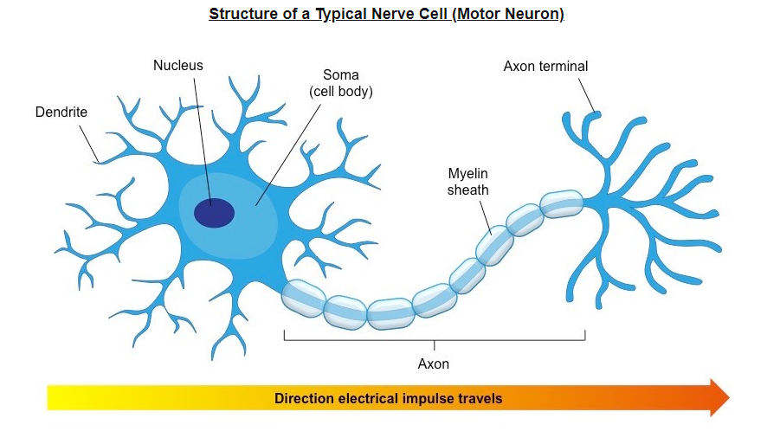
What is Neural Network?
Originally inspired by how human brain works.
Our brain has ~ ${10}^{11}$neurons, each of which communicates to ~ ${10}^{4}$other neurons

Slide 11
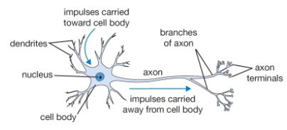
One Neuron

Slide 12
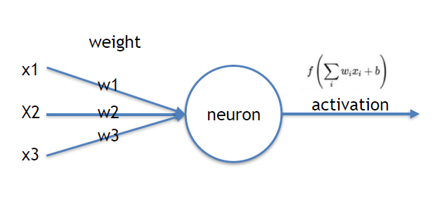
Mathematical representation of One Neuron
Think of x’s as electrical signals propagating through the axons from one neuron to the next
https://cs231n.github.io/neural-networks-1/

Slide 13
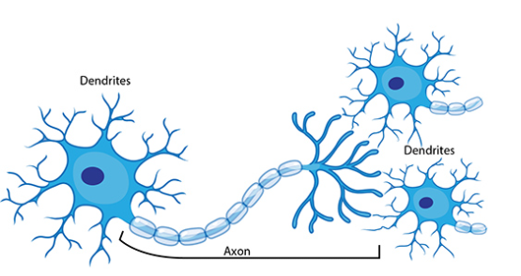
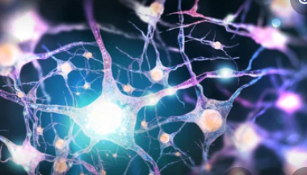
What is Neural Network?
Many neurons are connected with each others to form a network

Slide 14
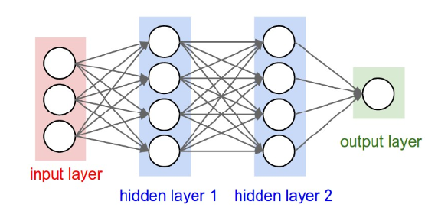
Simplified diagram of a Neural Network

Slide 15
What is Neural Network?
Using an analogy to the human brain, neural network is comprised of
Neurons which pass input values through functions and output the result
Weights which carry values between neurons
Neurons relate to each others through layers
We group neurons into layers. There are 3 main types of layers:
Input Layer
Hidden Layer(s)
Output Layer
If we have many hidden layers, we refer the network as “Deep Neural Network

Slide 16
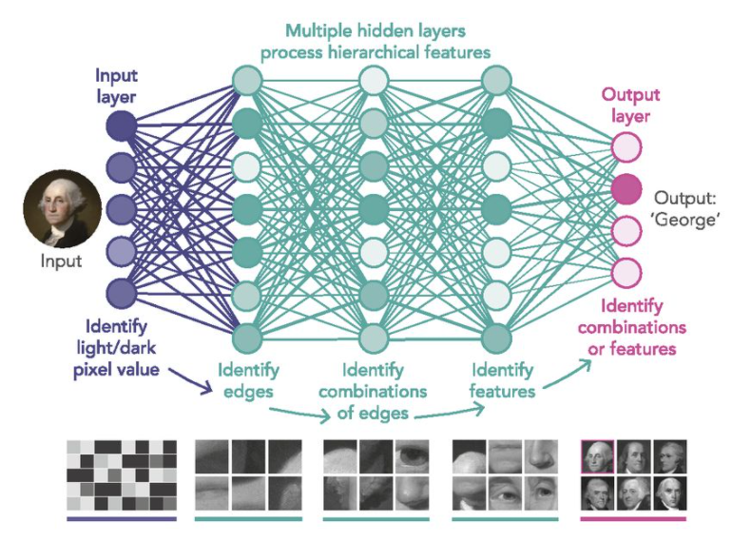
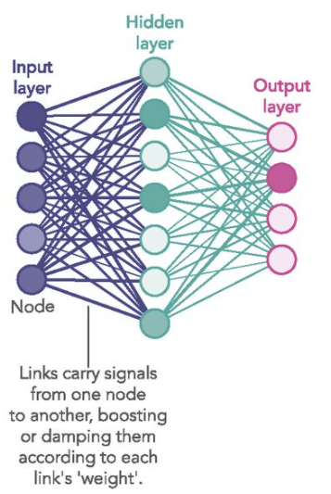
Shallow versus Deep Neural Network

Slide 17
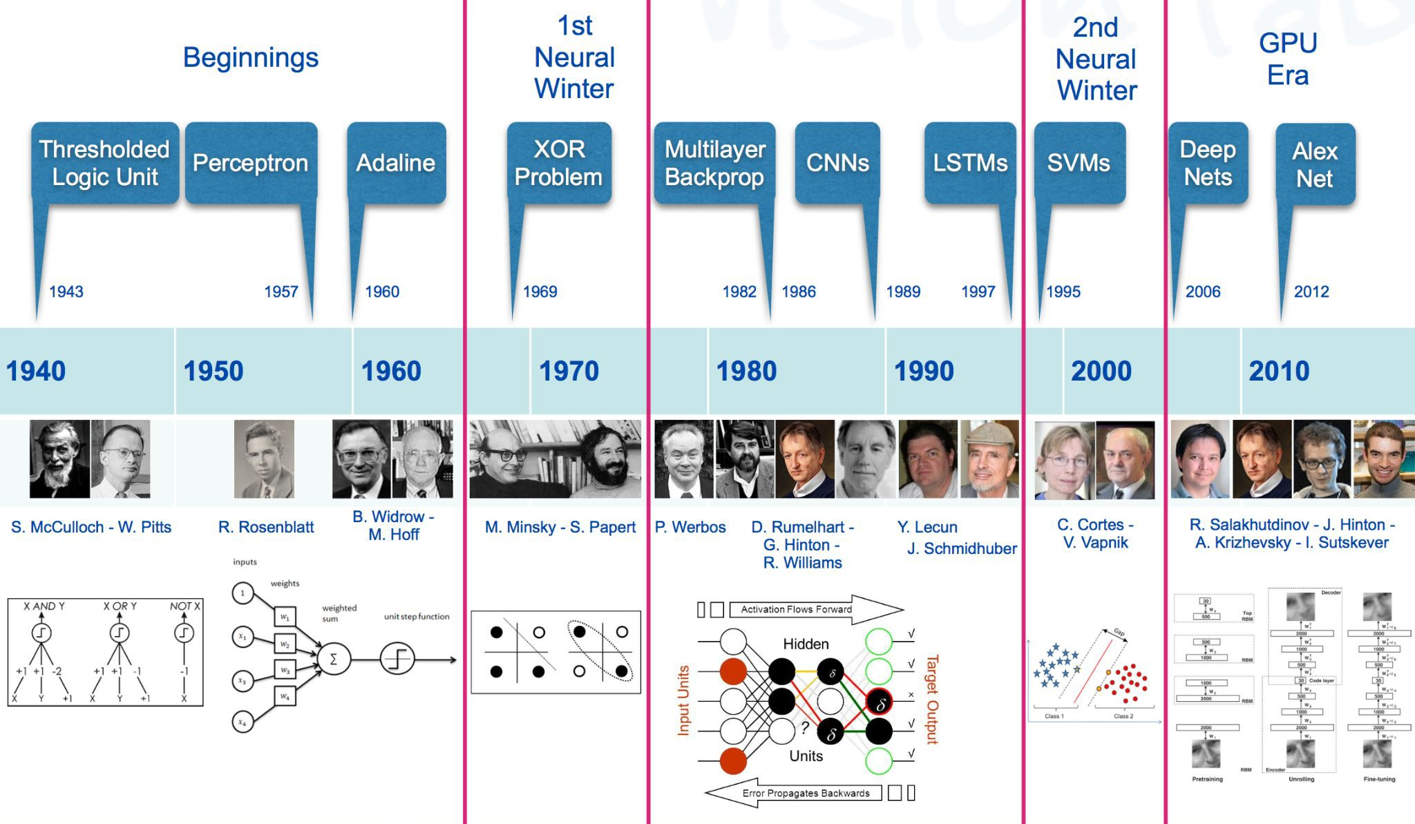
A bit of history

Slide 18
Why Deep and Why Now
Neural Network had been around from 1960, 1980, but people think it would not work (called Neural Network Winter)
Reasons why it didn’t catch up until recent was due to following reasons
Old ways of thinking a “over-parameterized” model is bad
Missing good algorithm to train “deep” neural network
Not enough data; thousand times smaller
Our computers was million times slower (there were no GPU)
We were using the wrong type of non-linearity
(according to Geoff Hinton)

Slide 19
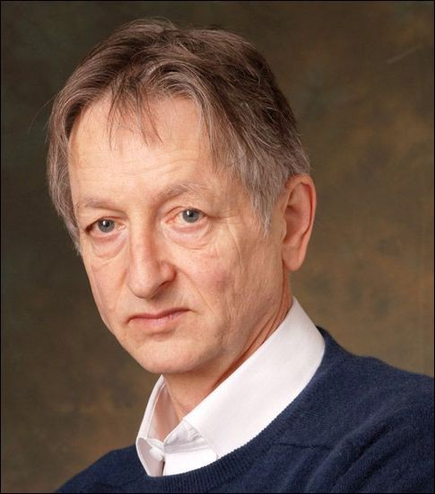
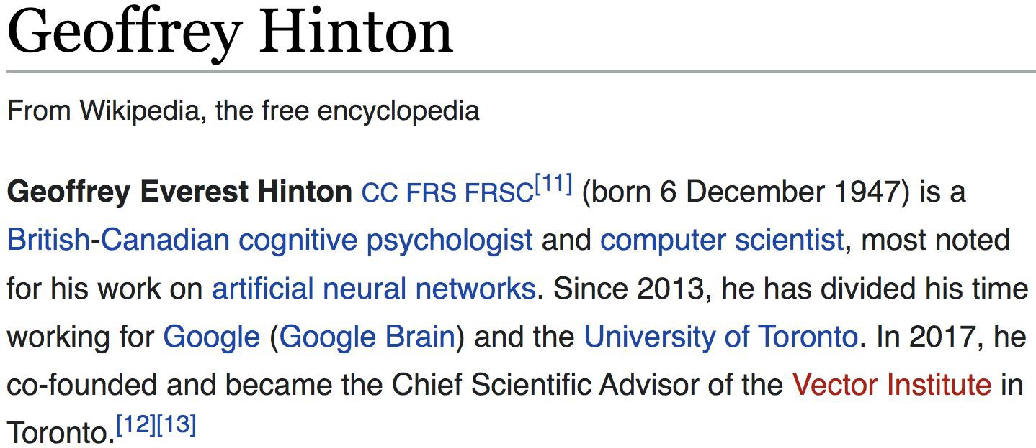
Why “Deep” and Why Now
He co-authored a paper in 2006 titled “A Fast Learning Algorithm for Deep Belief Nets” in which they describe an approach to training “deep” (as in a many layered network) of restricted Boltzmann machines.

Slide 20

Why Deep and Why Now
Turing Award 2019

Slide 21

Deep Learning vs. Traditional ML
Deep Learning can extract/learn features automatically!!!

Slide 22
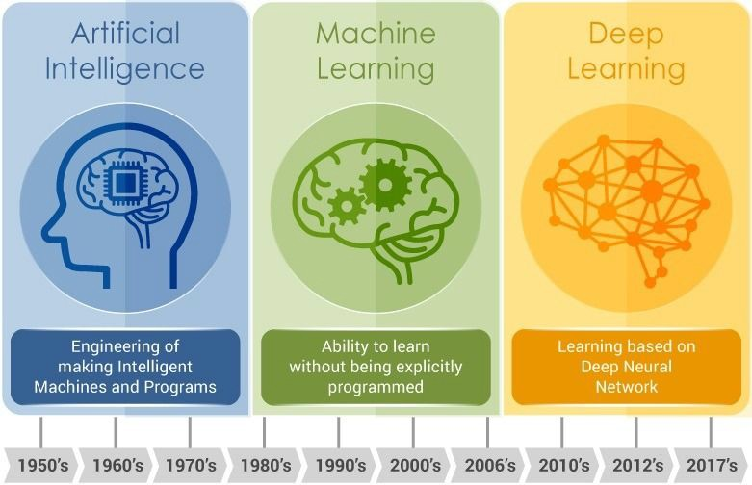
Deep Learning vs. Traditional ML

Slide 23
Deep Learning vs. Traditional ML
 | Deep Learning | Traditional ML
Where features come from? | learn automatically | human defined
Need data preprocessing? | usually no | yes
Need domain expert? | no | yes
Interpretability | almost no | yes
how to solve a problem | end-to-end | pipeline
Training time | usually long | short
hardware | GPU (fast) or CPU (slow) | CPU
Task Transferability | relatively strong | limited

Slide 24
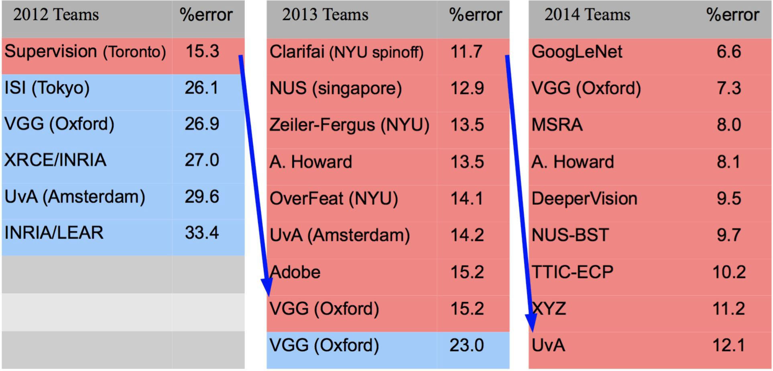
Impact of Deep Learning in Computer Vision
❏ 2012-2014 classification results in ImageNet
❏ 2015 results: ResNet under 3.5% error using 150 layers!

Slide 25
Outline
Introduction
What is Deep Learning?
What is neural network?
What characteristics that make it better?
Why now and Why deep?
Fundamental Building Blocks and Operations
Perceptron
Activation Functions
Working with Keras and Tensor Flow

Slide 26
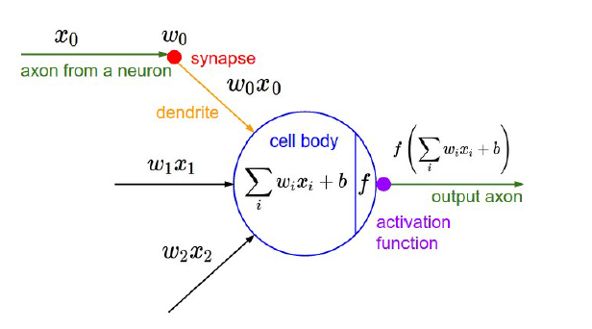
More details on the Mathematical Model of One Neuron
Think of x’s as electrical signals propagating through the axons from one neuron to the next
https://cs231n.github.io/neural-networks-1/

Slide 27
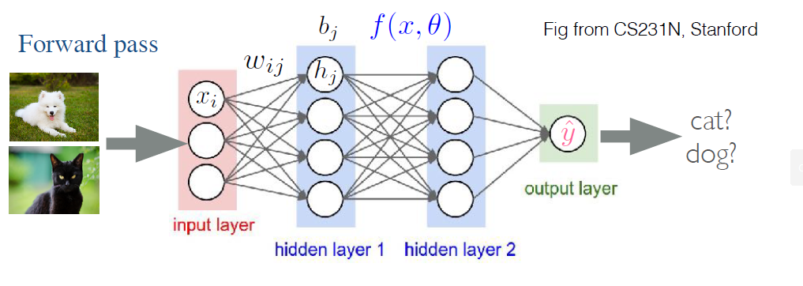
Hello World example of deep Neural Network

Slide 28
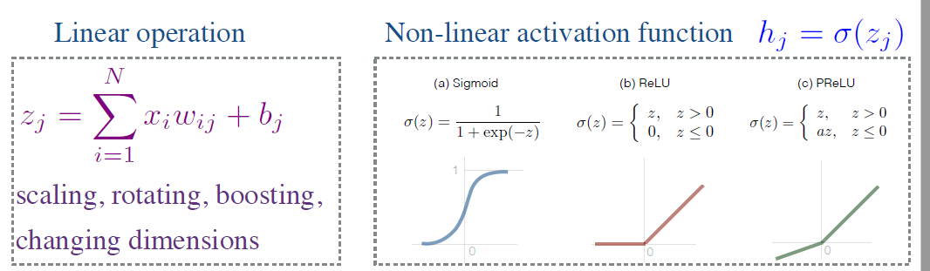
Preview

Slide 29
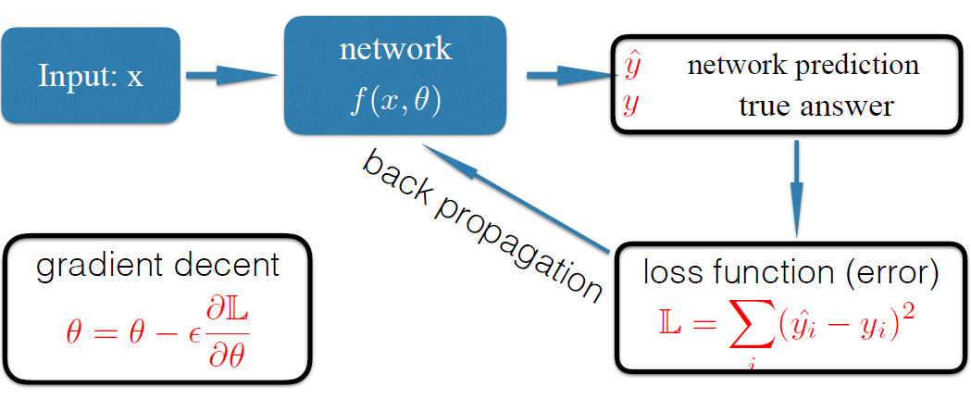
Anatomy of a Neural Network

Slide 30
How Neural Network solves learning problem?
Mathematically, a Neural Network is a black-box function mapping inputs into outputs.
Its power lies in two of its important characteristics when compared with other functions
The mapping can be as complicated as one can imagine. Mechanically it achieve its goal by going through a series of data transformations (or data representations)
No domain knowledge or typical features engineering needed in typical machine learning or statistical modeling, i.e. automatic features discovery
Both inputs and outputs can be multi-dimensional vectors and also be time-series
Inputs
Outputs
Black-Box Function

Slide 31
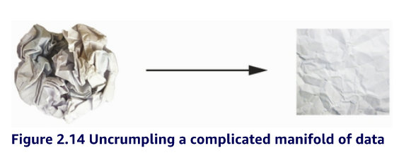
How Neural Network solves learning problem?
Uncrumpling paper balls is what machine learning is about: finding neat representations for complex, highly folded data manifolds. At this point, you should have a pretty good intuition as to why deep learning excels at this: it takes the approach of incrementally decomposing a complicated geometric transformation into a long chain of elementary ones, which is pretty much the strategy a human would follow to uncrumple a paper ball. Each layer in a deep network applies a transformation that disentangles the data a little—and a deep stack of layers makes tractable an extremely complicated disentanglement process.

Slide 32
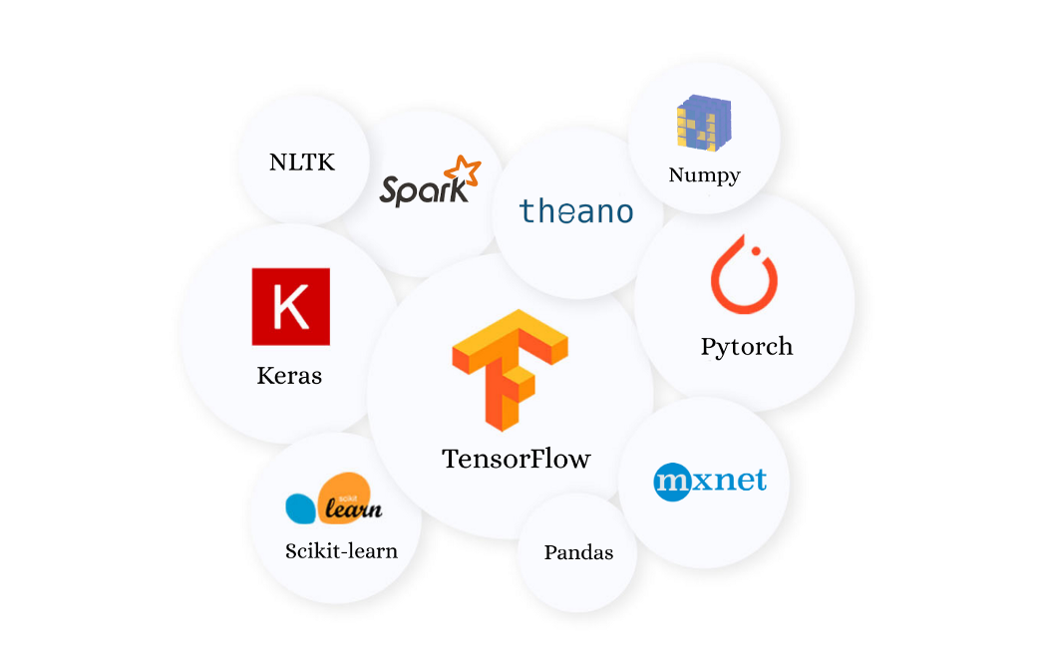
Libraries for Running Neural Network
TensorFlow
Keras
PyTorch
CNTK
Theano
Caffee
DeepLearning4J
https://www.tensorflow.org/
https://keras.io/
https://pytorch.org/

Slide 33
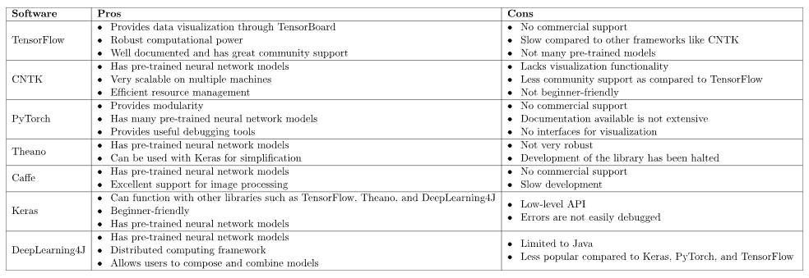
Libraries for Running Neural Network
https://www.baeldung.com/cs/ml-open-source-libraries

Slide 34
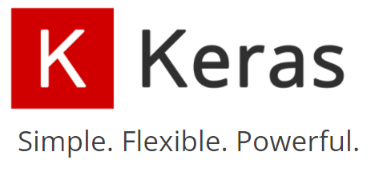
Libraries for Running Neural Network
We will focus on Keras

Slide 35


Keras as a library for Running Neural Network

Slide 36
The World is changing
PyTorch may take over ????
If you know TensorFlow, you can pick up PyTorch in no time

Slide 37
Learning by doing

